Slide 1
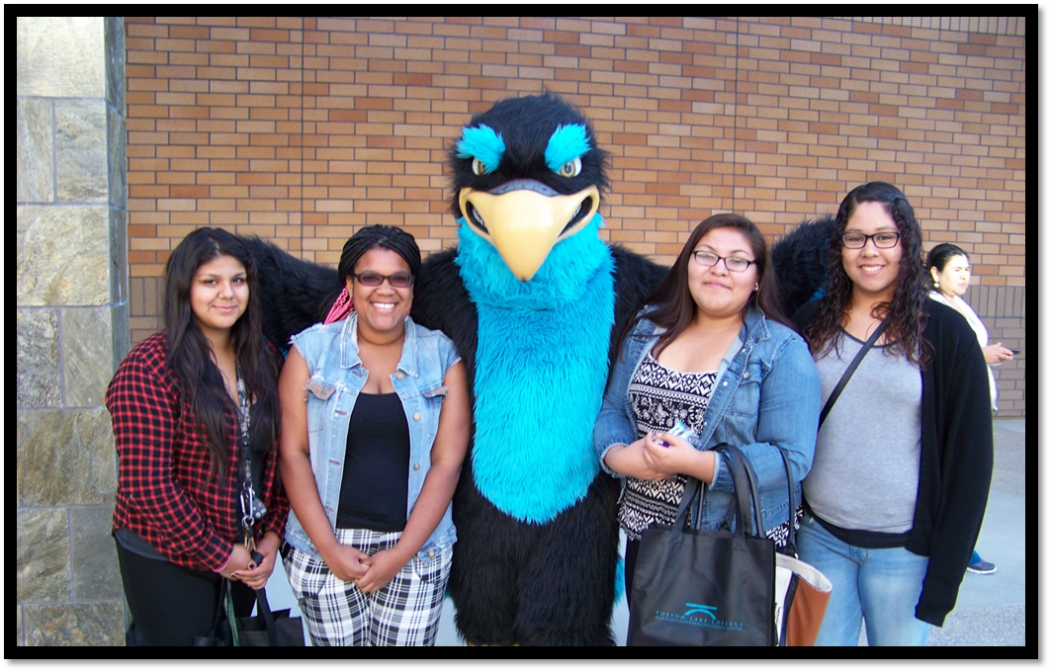
WELCOME!
Ponderosa and Oak Ridge Families
FOLSOM LAKE COLLEGE
LOS RIOS COMMUNITY COLLEGE DISTRICT

Slide 2
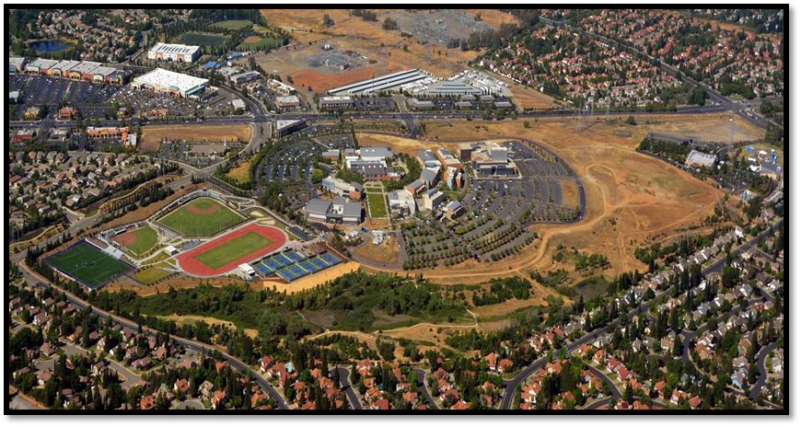
FOLSOM CAMPUS

Slide 3
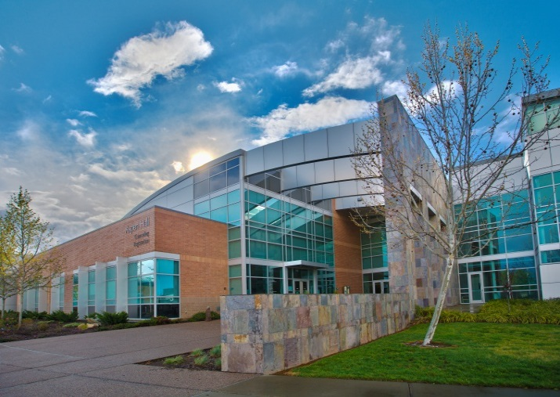
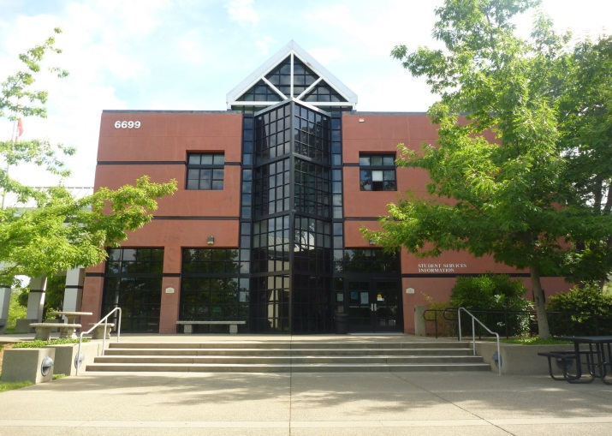
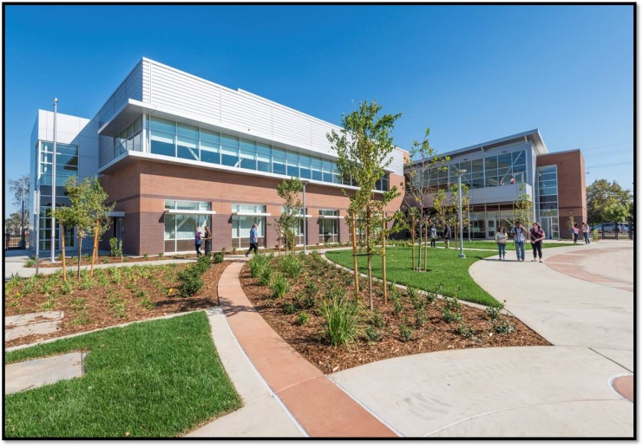
Locations to serve YOU
FOLSOM LAKE COLLEGE – FLC El Dorado Center – EDC
Rancho Cordova Center – RCC
state of the art facilities
Los Rios Community College District

Slide 4
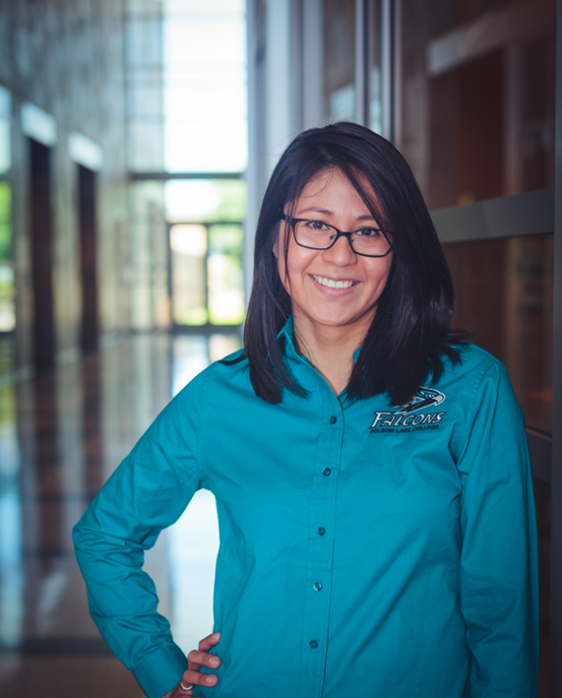
EXCELLENT ACADEMIC PROGRAMS
AA/AS DEGREES
39 different degree programs offered
TRANSFER DEGREES -CSU
Associate of Art for Transfer (AA-T)
Associate of Science for Transfer (AS-T)
CERTIFICATE PROGRAMS
37 different certificate programs offered
Career Technical Education (Vocational)
BASIC SKILLS COURSES
Remediation in English and Math
Our college catalog is FREE online!

Slide 5
TAG PROGRAM
Universities that offer the T.A.G. at FLC
UC Davis UC Irvine
UC Merced UC Riverside
UC Santa Barbara UC Santa Cruz
Golden Gate University St. Mary’s College
University of the Pacific Arizona State
CSU’s accept students that complete transfer requirements. (AA-T, AS-T)

Slide 6
Tuition Cost
$46 per unit for community college tuition
College Cost Comparison / 12 units per semester
CCC CSU UC Private
Tuition/Fees Per Year $1,104 $6,872 $13,400 $30,144 +
NOTE: Fees are subject to change, these are approximate costs based on college averages and programs.
Notes:
COST OF ATTENDANCE

Slide 7
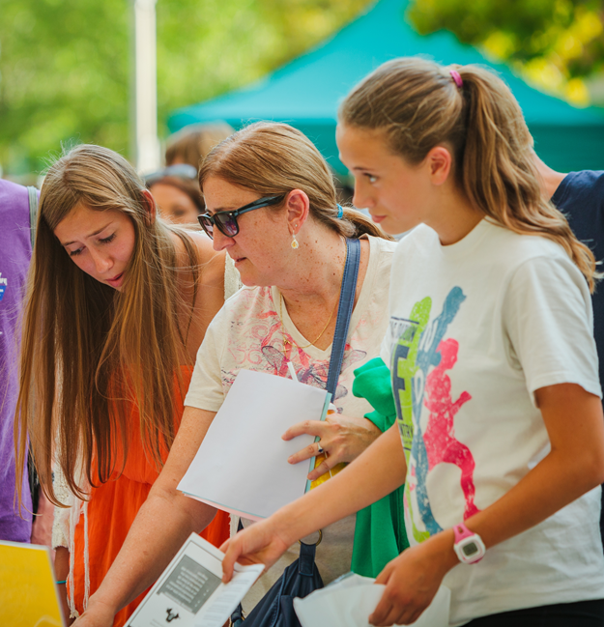
STUDENT SERVICES
Admissions
Career/Transfer Services
College Store
Computer Labs
Counseling
Disabled Student Program
Financial Aid
Library Services
Student Life
Tutoring
Visit our website for all services!

Slide 8
CAREER AND TRANSFER CENTER
Self-Discovery and Career Exploration
Career Counseling and Guidance
Step-by-Step Career Action Plan
Job Preparation (application, resume, and interview)
Career Planning and Transfer Workshops
Aisha Garroni – Majored in Administration of Justice and transferred to CSU, Sacramento

Slide 9
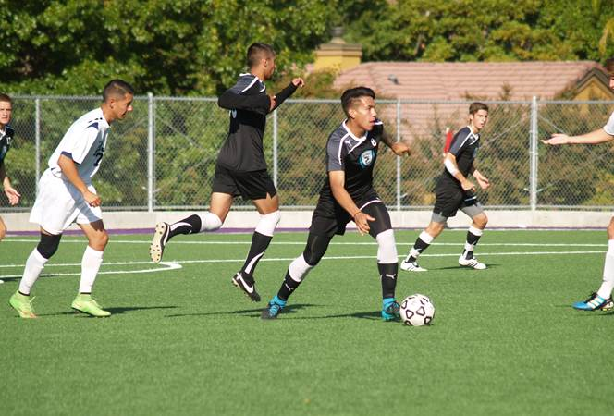
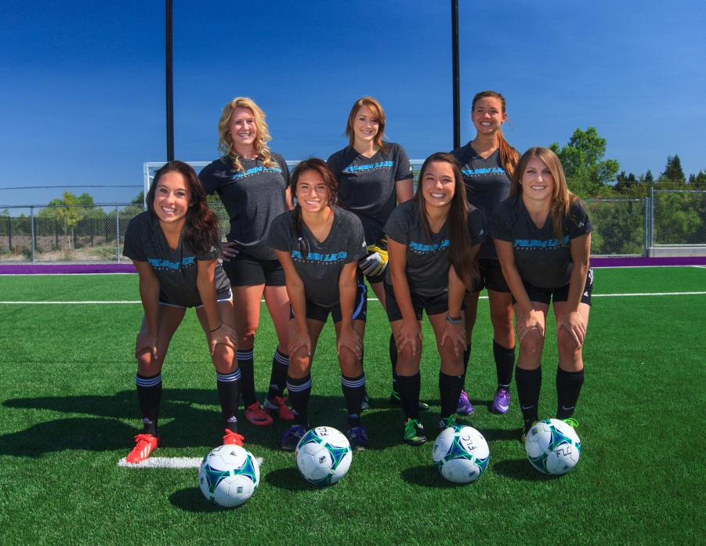
ATHLETICS
CURRENT SPORTS TEAMS: GOLF SOFTBALL
TENNIS VOLLEYBALL BASEBALL SOCCER

Slide 10
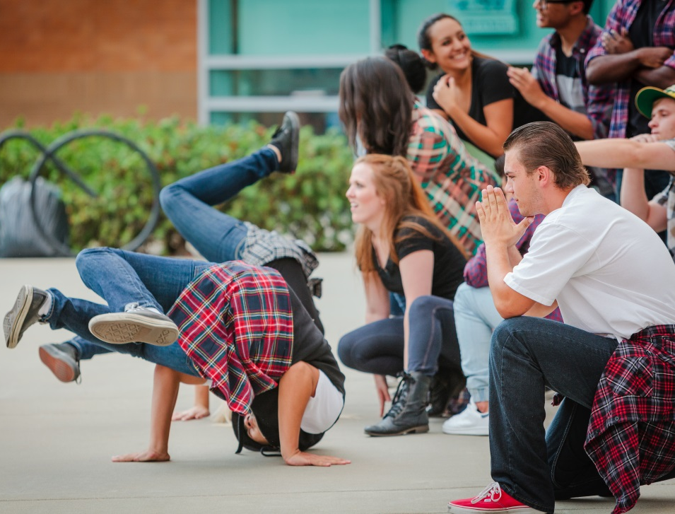
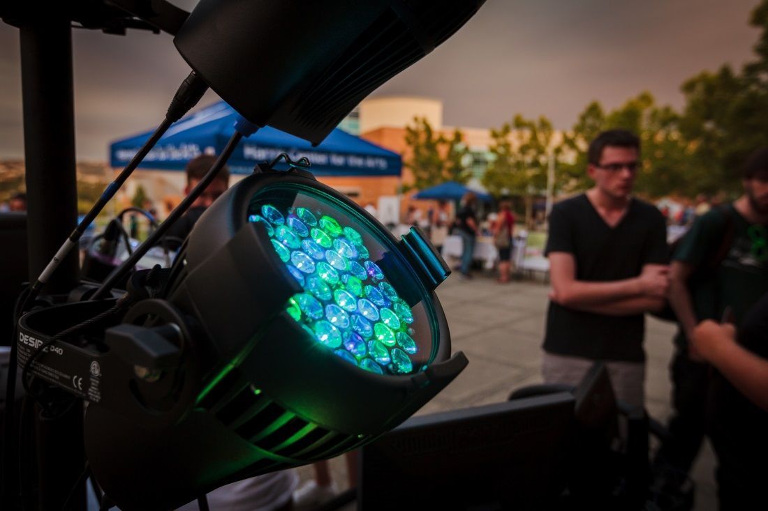
PERFORMING ARTS – HARRIS CENTER
Dance, Theatre, Music, Visual Arts

Slide 11
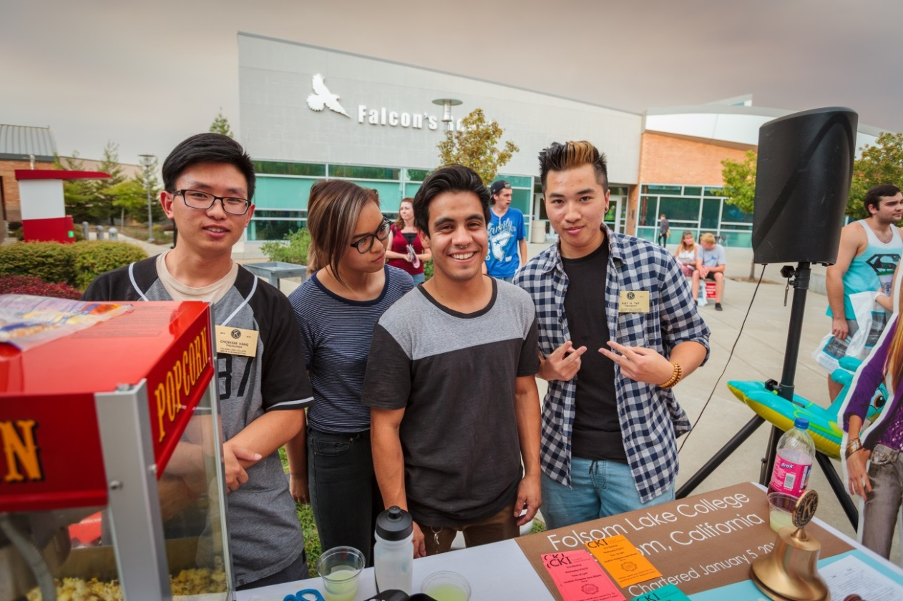
STUDENT LIFE – GET INVOLVED!
Associated Students Student Ambassadors
Clubs and Events
"I would encourage new students to get involved with campus clubs; ...it provides you with real world experiences that can be applied towards your major and leadership development."

Slide 12
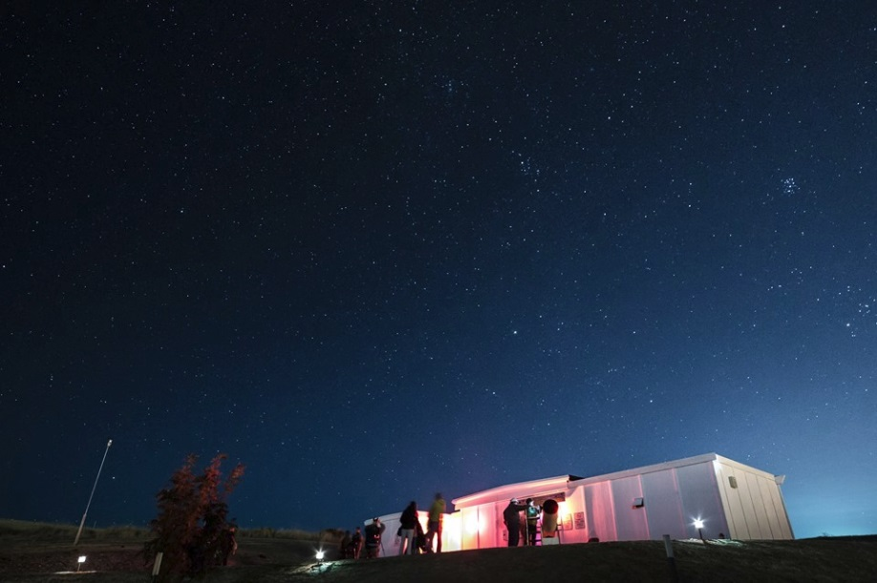
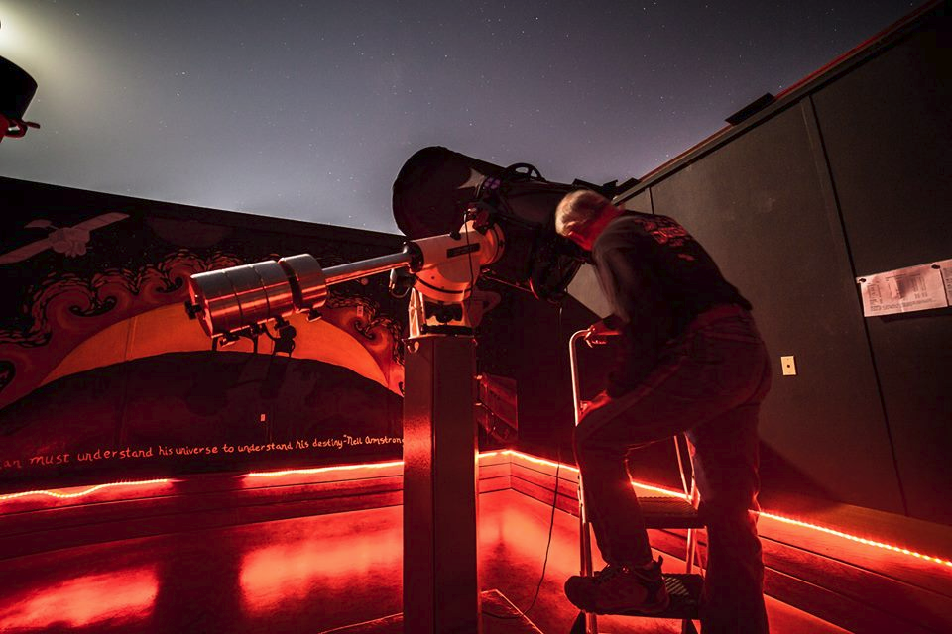
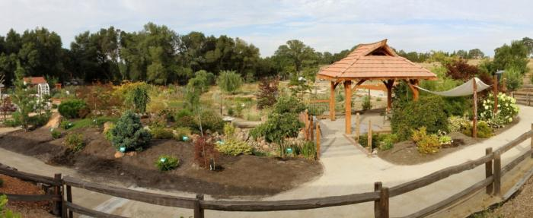
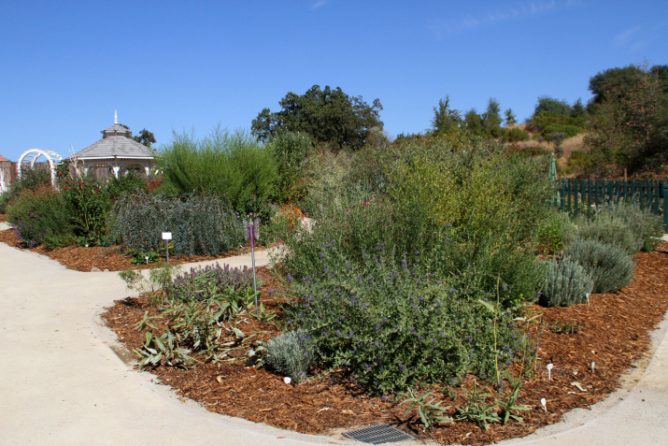
Community Observatory – at EDC Sherwood Demonstration Gardens

Slide 13
Step 1: APPLY
February 1 is the first date students may apply for the upcoming Summer/Fall Term.
(If you have an IEP – 504 on file call 916-608-6611 to make an intake appointment before continuing on to the next step.)
RECEIVE your Student ID number by email
within 1 hour of application submission.
Your Student ID is needed to complete each of your enrollment steps!.

Slide 14
Step 2: ORIENTATION
ORIENTATION is offered in an online format for the Los Rios Community College District.
You may begin orientation
the day after you apply and
receive your student ID!
Tours of our campus are also available.

Slide 15
Step 3: ASSESSMENT
Testing Dates reserved for Ponderosa
Tuesday, February 23rd 3:00pm & 5:15pm Rm FL1-107
Testing Dates reserved for Oak Ridge
Tuesday, February 16th 3:00pm & 5:15pm Rm FL1-107
OTHER DROP IN TIMES:
Saturday, February 27th 9 am – 1 pm Rm FL1 - 107
Saturday, March 12th 9am – 1 pm Rm FL1 - 107
PLAN AHEAD… STUDY FOR THE TEST NOW!
Assessment Preparation Tutorials, study guides , & practice tests online.
Results will be given to students directly after testing.
Results are needed in order to develop an education plan.

Slide 16
Step 4: ACADEMIC PLAN
ACADEMIC PLANNING SESSION
Students should plan on attending an academic planning session after completing assessment testing. During this planning session, you will put together a first semester education plan with academic counselors.
Steps #1-4 MUST be completed by April 1st (for Summer/Fall terms) in order to receive an earlier priority registration date.
Students may complete these steps at any time to enroll for classes during open registration.

Slide 17
Step 5: REGISTRATION
CLASS SCHEDULE for SUMMER/FALL – POSTED MARCH 23RD
Students can start creating a schedule for both Summer and Fall.
Registration for first time college students will happen around May 6-10, students will be assigned a date and time to register online.
We will be hosting registration workshops at both Oak Ridge and Ponderosa to help students with e-Services. Check with your career center staff!

Slide 18
YOU’VE GOT MAIL!

Slide 19
PLEASE JOIN US!
A DAY FOR NEW STUDENTS TO GET TOGETHER AND LEARN ABOUT
FOLSOM LAKE COLLEGE

Slide 20
For more information:
Contact: Sarah Aldea, Outreach Specialist
530-642-5623
916-608-6589
aldeas@flc.losrios.edu
Folsom Lake College Website
www.flc.losrios.edu

